Slide 1
CPSC331 - Spring 2019 Tutorial 14
Khobaib Zaamout

Slide 2
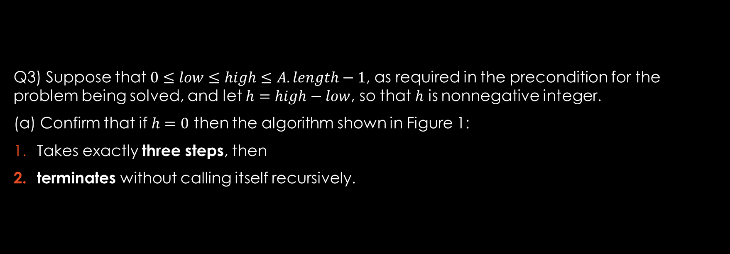

Q3.a: if $h=0$ then
Q3) Suppose that $0≤low≤high≤A.length−1$, as required in the precondition for the problem being solved, and let $h=high−low$, so that $h$ is nonnegative integer.
(a) Confirm that if $h=0$ then the algorithm shown in Figure 1:
Takes exactly three steps, then
terminates without calling itself recursively.

Slide 3
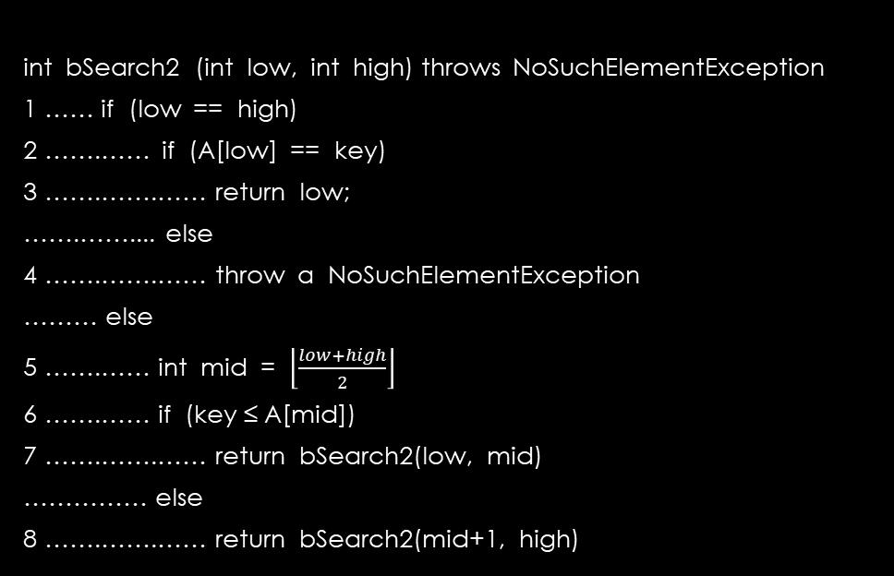
Q3.a: if $h=0$ then
Work Area
Algorithm:
int bSearch2 (int low, int high) throws NoSuchElementException
1 …… if (low == high)
2 …….…… if (A[low] == key)
3 …….…….…… return low;
…….…….... else
4 …….…….…… throw a NoSuchElementException
……… else
5 …….…… int mid = $\left\lfloor \frac{low+high}{2}\right\rfloor$
6 …….…… if (key ≤ A[mid])
7 …….…….…… return bSearch2(low, mid)
…………… else
8 …….…….…… return bSearch2(mid+1, high)

Slide 4

Q3.a: if $h=0$ then
Work Area
Algorithm:
From the question, we know:
$h=high−low$
$h=0$
int bSearch2 (int low, int high) throws NoSuchElementException
1 …… if (low == high)
2 …….…… if (A[low] == key)
3 …….…….…… return low;
…….…….... else
4 …….…….…… throw a NoSuchElementException
……… else
5 …….…… int mid = $\left\lfloor \frac{low+high}{2}\right\rfloor$
6 …….…… if (key ≤ A[mid])
7 …….…….…… return bSearch2(low, mid)
…………… else
8 …….…….…… return bSearch2(mid+1, high)

Slide 5

Q3.a: if $h=0$ then
Work Area
Algorithm:
From the question, we know:
$h=high−low$
$h=0$
Therefore, $high−low=0$ and $high=low$
int bSearch2 (int low, int high) throws NoSuchElementException
1 …… if (low == high)
2 …….…… if (A[low] == key)
3 …….…….…… return low;
…….…….... else
4 …….…….…… throw a NoSuchElementException
……… else
5 …….…… int mid = $\left\lfloor \frac{low+high}{2}\right\rfloor$
6 …….…… if (key ≤ A[mid])
7 …….…….…… return bSearch2(low, mid)
…………… else
8 …….…….…… return bSearch2(mid+1, high)

Slide 6
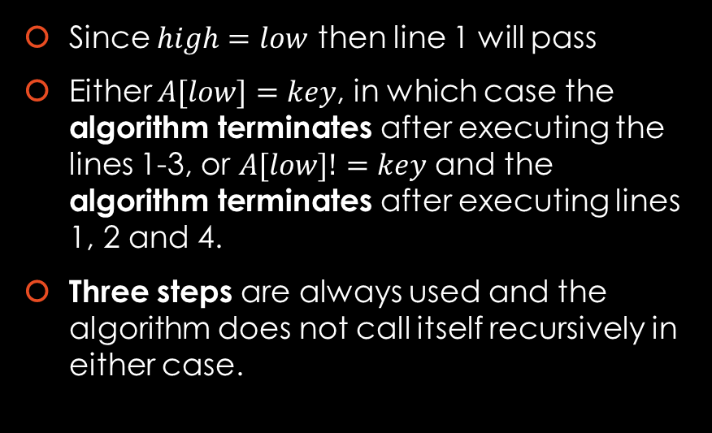
Q3.a: if $h=0$ then
Work Area
Algorithm:
Since $high=low$ then line 1 will pass
Either $A[low]=key$, in which case the algorithm terminates after executing the lines 1-3, or $A[low]!=key$ and the algorithm terminates after executing lines 1, 2 and 4.
Three steps are always used and the algorithm does not call itself recursively in either case.
int bSearch2 (int low, int high) throws NoSuchElementException
1 …… if (low == high)
2 …….…… if (A[low] == key)
3 …….…….…… return low;
…….…….... else
4 …….…….…… throw a NoSuchElementException
……… else
5 …….…… int mid = $\left\lfloor \frac{low+high}{2}\right\rfloor$
6 …….…… if (key ≤ A[mid])
7 …….…….…… return bSearch2(low, mid)
…………… else
8 …….…….…… return bSearch2(mid+1, high)

Slide 7
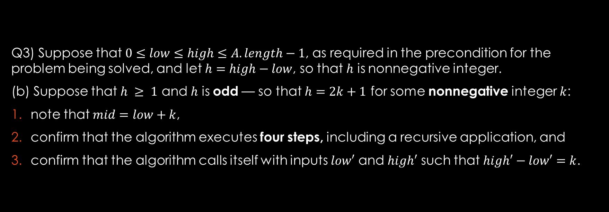

Q3.b: Suppose that $h ≥ 1$ and $h$ is odd
Q3) Suppose that $0≤low≤high≤A.length−1$, as required in the precondition for the problem being solved, and let $h=high−low$, so that $h$ is nonnegative integer.
(b) Suppose that $h ≥ 1$ and $h$ is odd — so that $h=2k+1$ for some nonnegative integer $k$:
note that $mid=low+k$,
confirm that the algorithm executes four steps, including a recursive application, and
confirm that the algorithm calls itself with inputs $low′$ and $high′$ such that $high′−low′=k$.

Slide 8
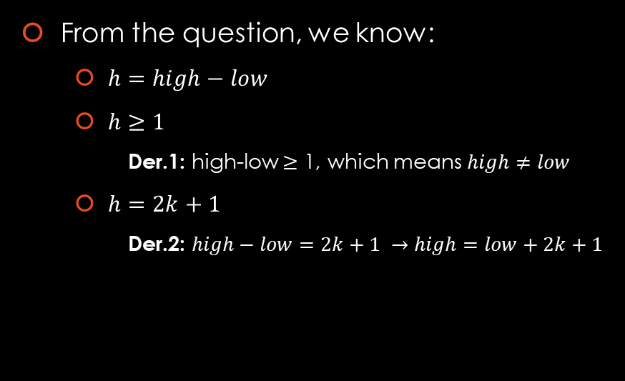
Q3.b: Suppose that $h ≥ 1$ and $h$ is odd
Work Area
Algorithm:
From the question, we know:
$h=high−low$
$h≥1$
Der.1: high-low $≥$ 1, which means $high≠low$
$h=2k+1$
Der.2: $high−low=2k+1 →high=low+2k+1$
int bSearch2 (int low, int high) throws NoSuchElementException
1 …… if (low == high)
2 …….…… if (A[low] == key)
3 …….…….…… return low;
…….…….... else
4 …….…….…… throw a NoSuchElementException
……… else
5 …….…… int mid = $\left\lfloor \frac{low+high}{2}\right\rfloor$
6 …….…… if (key ≤ A[mid])
7 …….…….…… return bSearch2(low, mid)
…………… else
8 …….…….…… return bSearch2(mid+1, high)

Slide 9
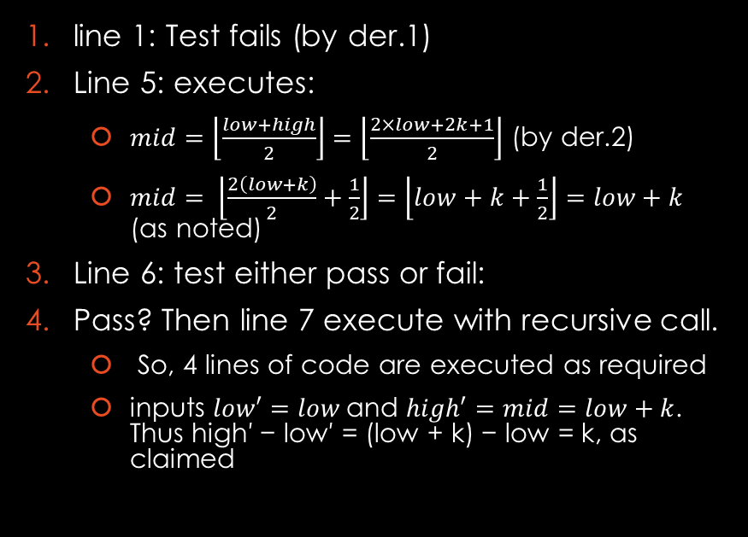
Q3.b: Suppose that $h ≥ 1$ and $h$ is odd
Work Area
Algorithm:
line 1: Test fails (by der.1)
Line 5: executes:
$mid=\left\lfloor \frac{low+high}{2}\right\rfloor =\left\lfloor \frac{2×low+2k+1}{2}\right\rfloor$ (by der.2)
$mid= \left\lfloor \frac{2\left(low+k\right)}{2}+\frac{1}{2}\right\rfloor =\left\lfloor low+k+\frac{1}{2}\right\rfloor =low+k$ (as noted)
Line 6: test either pass or fail:
Pass? Then line 7 execute with recursive call.
So, 4 lines of code are executed as required
inputs $low′=low$and $high′=mid=low+k$. Thus high′ − low′ = (low + k) − low = k, as claimed
int bSearch2 (int low, int high) throws NoSuchElementException
1 …… if (low == high)
2 …….…… if (A[low] == key)
3 …….…….…… return low;
…….…….... else
4 …….…….…… throw a NoSuchElementException
……… else
5 …….…… int mid = $\left\lfloor \frac{low+high}{2}\right\rfloor$
6 …….…… if (key ≤ A[mid])
7 …….…….…… return bSearch2(low, mid)
…………… else
8 …….…….…… return bSearch2(mid+1, high)

Slide 10
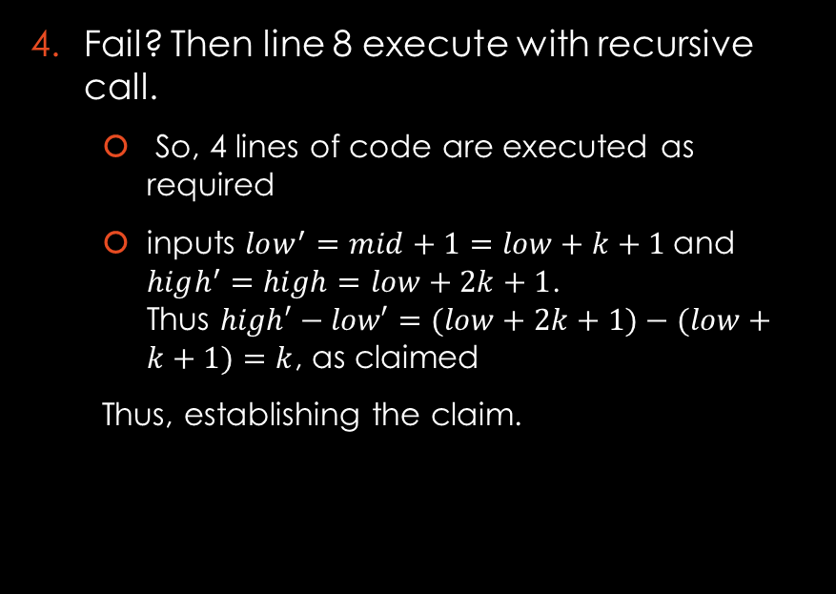
Q3.b: Suppose that $h ≥ 1$ and $h$ is odd
Work Area
Algorithm:
Fail? Then line 8 execute with recursive call.
So, 4 lines of code are executed as required
inputs $low^{′}=mid+1=low+k+1$and $high^{′}=high=low+2k+1$. Thus $high′−low′=(low+2k+1)−(low+k+1)=k$, as claimed
Thus, establishing the claim.
int bSearch2 (int low, int high) throws NoSuchElementException
1 …… if (low == high)
2 …….…… if (A[low] == key)
3 …….…….…… return low;
…….…….... else
4 …….…….…… throw a NoSuchElementException
……… else
5 …….…… int mid = $\left\lfloor \frac{low+high}{2}\right\rfloor$
6 …….…… if (key ≤ A[mid])
7 …….…….…… return bSearch2(low, mid)
…………… else
8 …….…….…… return bSearch2(mid+1, high)

Slide 11
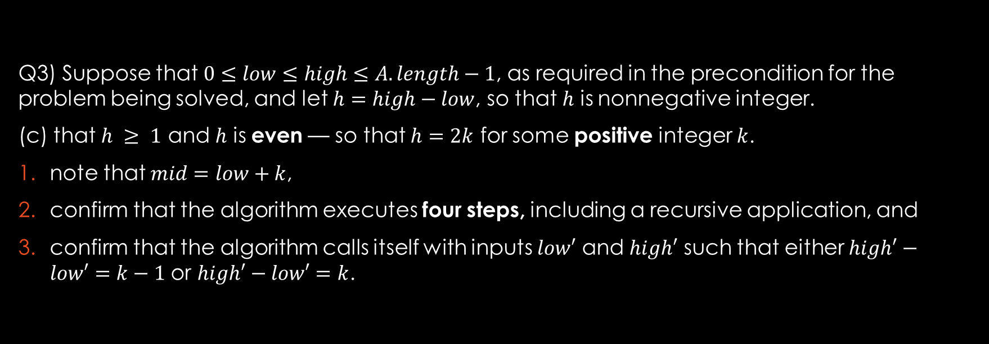

Q3.c: Suppose that $h ≥ 1$ and $h$ is even
Q3) Suppose that $0≤low≤high≤A.length−1$, as required in the precondition for the problem being solved, and let $h=high−low$, so that $h$ is nonnegative integer.
(c) that $h ≥ 1$ and $h$ is even — so that $h=2k$ for some positive integer $k$.
note that $mid=low+k$,
confirm that the algorithm executes four steps, including a recursive application, and
confirm that the algorithm calls itself with inputs $low′$ and $high′$ such that either $high′−low′=k−1$ or $high′−low′=k$.

Slide 12
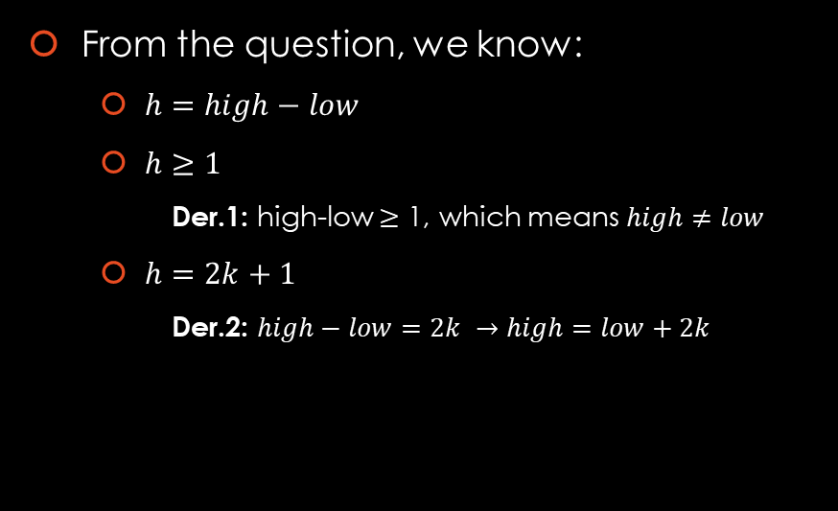
Q3.c: Suppose that $h ≥ 1$ and $h$ is even
Work Area
Algorithm:
From the question, we know:
$h=high−low$
$h≥1$
Der.1: high-low $≥$ 1, which means $high≠low$
$h=2k+1$
Der.2: $high−low=2k →high=low+2k$
int bSearch2 (int low, int high) throws NoSuchElementException
1 …… if (low == high)
2 …….…… if (A[low] == key)
3 …….…….…… return low;
…….…….... else
4 …….…….…… throw a NoSuchElementException
……… else
5 …….…… int mid = $\left\lfloor \frac{low+high}{2}\right\rfloor$
6 …….…… if (key ≤ A[mid])
7 …….…….…… return bSearch2(low, mid)
…………… else
8 …….…….…… return bSearch2(mid+1, high)

Slide 13
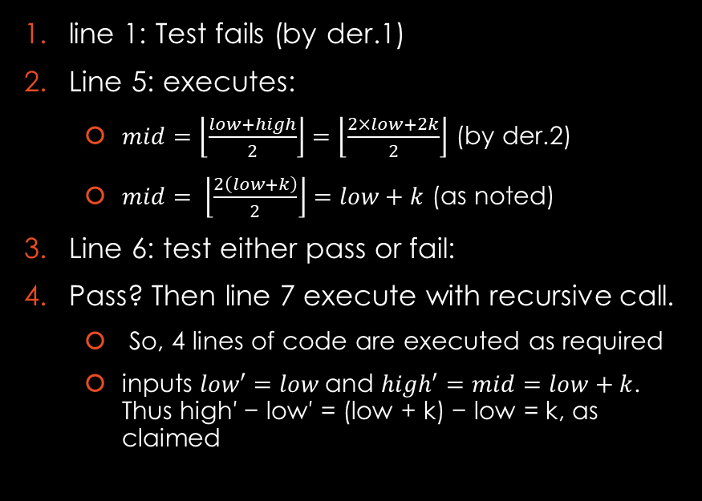
Q3.c: Suppose that $h ≥ 1$ and $h$ is even
Work Area
Algorithm:
line 1: Test fails (by der.1)
Line 5: executes:
$mid=\left\lfloor \frac{low+high}{2}\right\rfloor =\left\lfloor \frac{2×low+2k}{2}\right\rfloor$ (by der.2)
$mid= \left\lfloor \frac{2\left(low+k\right)}{2}\right\rfloor =low+k$ (as noted)
Line 6: test either pass or fail:
Pass? Then line 7 execute with recursive call.
So, 4 lines of code are executed as required
inputs $low′=low$and $high′=mid=low+k$. Thus high′ − low′ = (low + k) − low = k, as claimed
int bSearch2 (int low, int high) throws NoSuchElementException
1 …… if (low == high)
2 …….…… if (A[low] == key)
3 …….…….…… return low;
…….…….... else
4 …….…….…… throw a NoSuchElementException
……… else
5 …….…… int mid = $\left\lfloor \frac{low+high}{2}\right\rfloor$
6 …….…… if (key ≤ A[mid])
7 …….…….…… return bSearch2(low, mid)
…………… else
8 …….…….…… return bSearch2(mid+1, high)

Slide 14
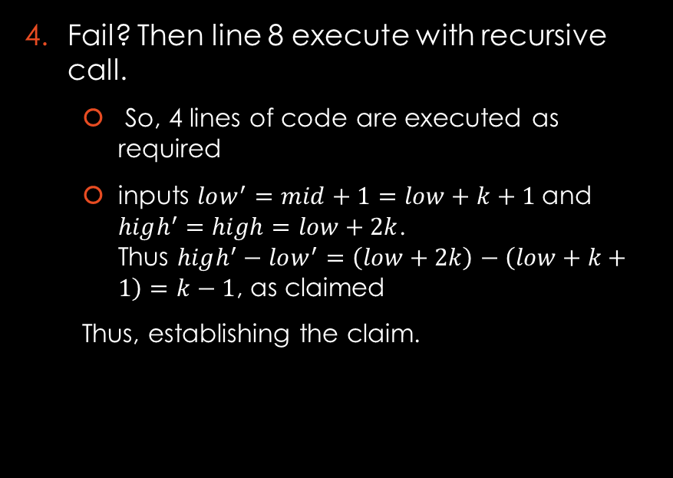
Q3.c: Suppose that $h ≥ 1$ and $h$ is even
Work Area
Algorithm:
Fail? Then line 8 execute with recursive call.
So, 4 lines of code are executed as required
inputs $low^{′}=mid+1=low+k+1$and $high^{′}=high=low+2k$. Thus $high^{′}−low^{′}=\left(low+2k\right)−\left(low+k+1\right)=k−1$, as claimed
Thus, establishing the claim.
int bSearch2 (int low, int high) throws NoSuchElementException
1 …… if (low == high)
2 …….…… if (A[low] == key)
3 …….…….…… return low;
…….…….... else
4 …….…….…… throw a NoSuchElementException
……… else
5 …….…… int mid = $\left\lfloor \frac{low+high}{2}\right\rfloor$
6 …….…… if (key ≤ A[mid])
7 …….…….…… return bSearch2(low, mid)
…………… else
8 …….…….…… return bSearch2(mid+1, high)

Slide 15
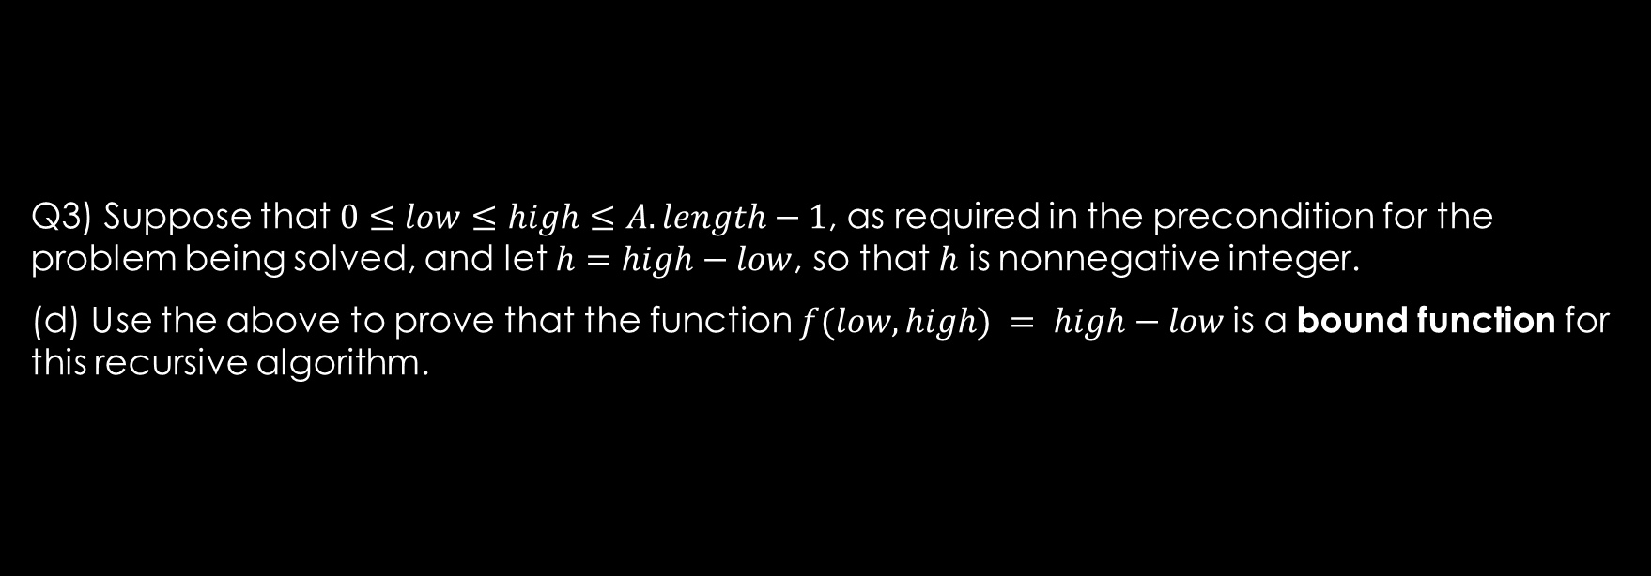

Q3.d: prove that $f$ is a bound function
Q3) Suppose that $0≤low≤high≤A.length−1$, as required in the precondition for the problem being solved, and let $h=high−low$, so that $h$ is nonnegative integer.
(d) Use the above to prove that the function $f(low, high) = high−low$is a bound function for this recursive algorithm.

Slide 16
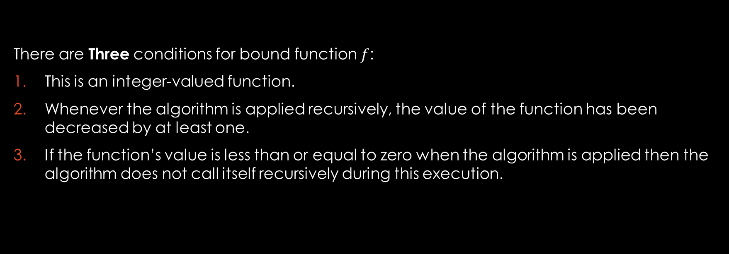
Q3.d: prove that $f$ is a bound function
There are Three conditions for bound function $f$:
This is an integer-valued function.
Whenever the algorithm is applied recursively, the value of the function has been decreased by at least one.
If the function’s value is less than or equal to zero when the algorithm is applied then the algorithm does not call itself recursively during this execution.

Slide 17
Q3.d: prove that $f$ is a bound function
Answer:
Low and high are integers and are subtracted, therefore, f is an integer valued function.
The value of this function either drops from 2k + 1 to k, for a non-negative integer k (so that it drops by (2k+1)−k = k+1 ≥ 1,
Or it drops from 2k to either k or k − 1 for a positive integer k, so that its value drops by at least 2k − k = k ≥ 1 in both cases it drops by at least 1.
If f(low, high) ≤ 0, it means that high – low ≤ 0, so high ≤ low
Also low ≤ high (precondition)
From above we can say low = high and in section “a” we showed that the algorithm terminates in this case. Therefore, the function terminates and does not call it self again when f(low, high) ≤ 0.
All three conditions are met therefore f is a bound function.

